Slide 1
Assembly Language
Lab 3
2022/10/03

Slide 2
Objectives
Complete the following code.
Use loop to calculate multiplication table from 9*1 to 9*9.
.data
Result byte 9 DUP(?)
.code
Main PROC
Mov ecx, ______
Mov esi, OFFSET Result
; Please Write your code here.
exit
main ENDP
END main

Slide 3
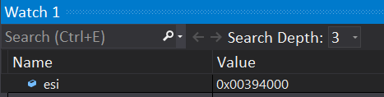


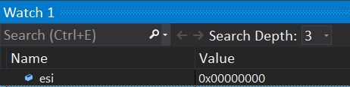
How to use esi register
0x00394000 is the memory address, which means that the memory address starts to store the contents of the result variable. The above code represents putting the contents of the ax register into the memory address of 0x00394000.
esi represents a counter, and myID[esi] represents the content of the number of digits in the myID variable. Code above represents putting the 0th digit in the myID variable into al register
★The two usage methods cannot be mixed up!! That is, the situation of myID[00403000] cannot appear, because the variable size of myID will be exceeded.

Slide 4
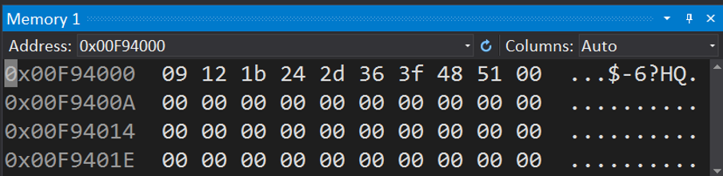
Result
Use the Memory Window to view the value of the variable Result
The sequence is 09 12 1b 24 2d 36 3f 48 51

Slide 5
Report
Due to tomorrow (2022/10/04)
Before 12:00
If you submit late, please send a letter to the teaching assistant, points will be deducted
Group Task
Compress(.zip,.rar) the following file with the name of the group ( e.g. lab3_01.zip)
Code(lab3_01.asm)
Report(lab3_01.doc or lab3_01.pdf)
Report Title
Group, name, student ID
Step by step of program execution flow, memory (register) status
Screenshots description, code Description
Reviews for the class, lesson learned, the tools we used, TA, etc

Slide 6
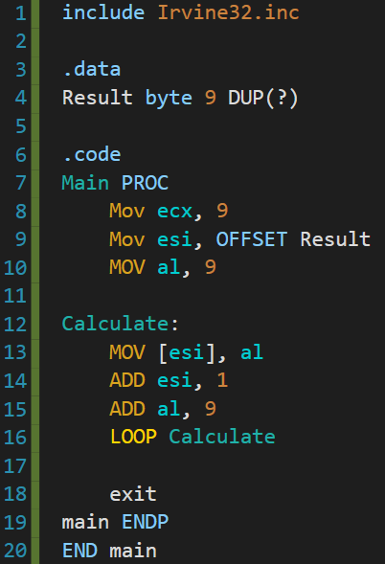
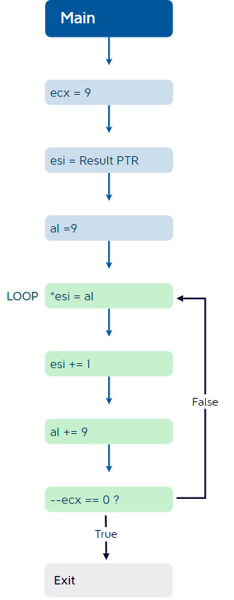















Register before start
Setting 9 as our limit of loops by assigning a 9 to ecx register
Here we ask esi to point to the first position of Result
Setting a initial value of 9 to al
Moving the al value to the designated esi position
Shifting to the next position of esi
( Result’s next element )
Adding 9 to al
Telling assembler where to start looping again ( In this case it goes back to line 12 )
Final Result

